Slide 1
Agenda for Module 2
Part 1:
Introduction to Algorithms
Data Structures
Part 2:
Search Algorithms
Time Complexity
Part 3:
Sorting Algorithms
Part 4:
Graph Algorithms
Algorithmic Techniques

Slide 2
Sorting Algorithms
Sorting algorithm is an algorithm that puts elements of a list in a certain order
Sorting is a fundamental operation in computer science and algorithms
Many algorithms use it as an intermediate step
There are several sorting algorithms, differing in their efficiency.

Slide 3
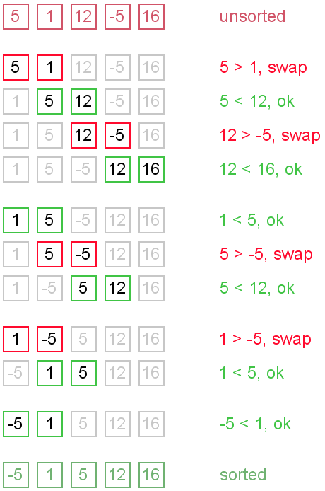


Bubble Sort
Go through the list:
If the next element is smaller:
SWAP!

Slide 4
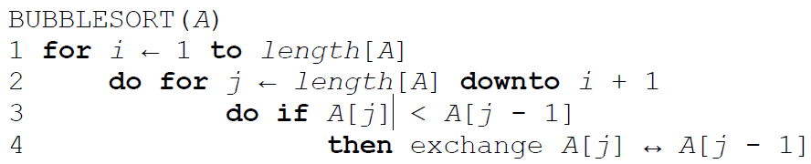
Bubble Sort

Slide 5
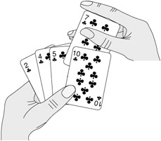
Insertion Sort
Start with empty left hand
Pick one card at a time
Insert it into the correct position in left hand
To find correct position, compare it with each of the cards already in hand

Slide 6
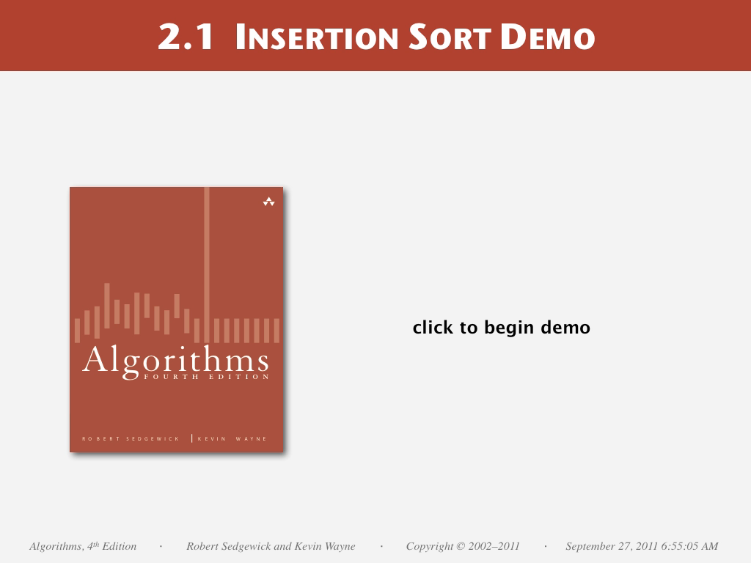

Slide 7
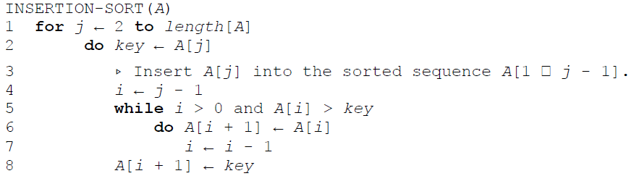
Insertion Sort

Slide 8
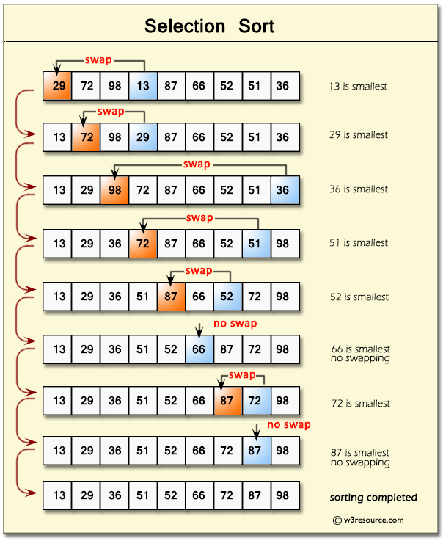
Selection Sort
In iteration i, find index of the smallest entry in unsorted part of the list
Swap a[i] and a[min]
i ← i + 1
Notes:
Bubble sort
Insertion

Slide 9


Slide 10
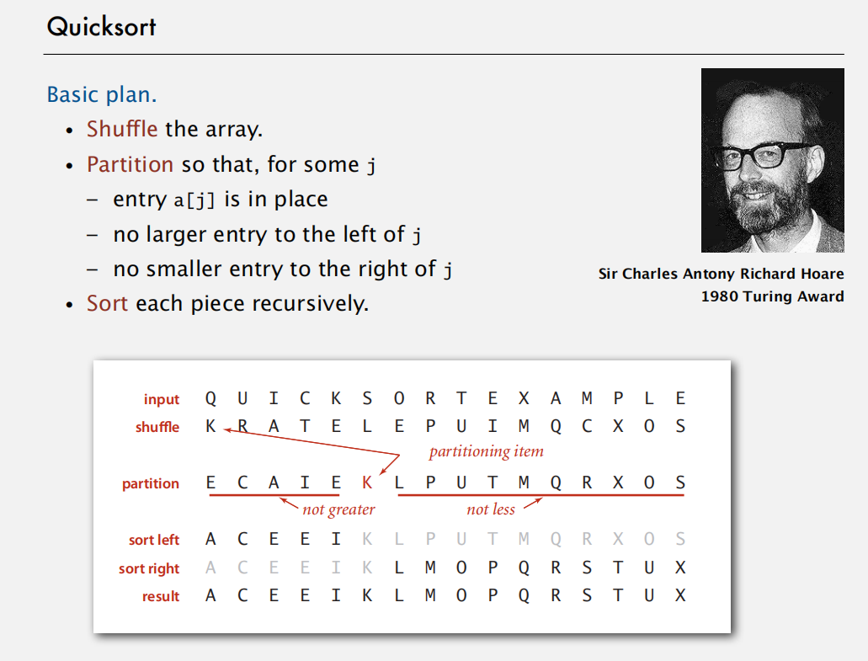
Quick Sort

Slide 11
Quick Sort Partitioning Demo
23DemoPartitioning.pdf

Slide 12
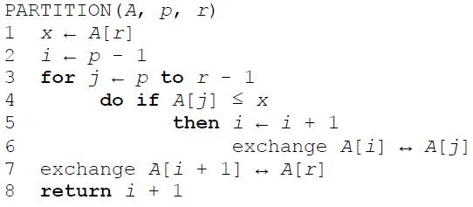
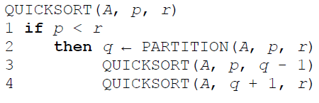
Quicksort

Slide 13
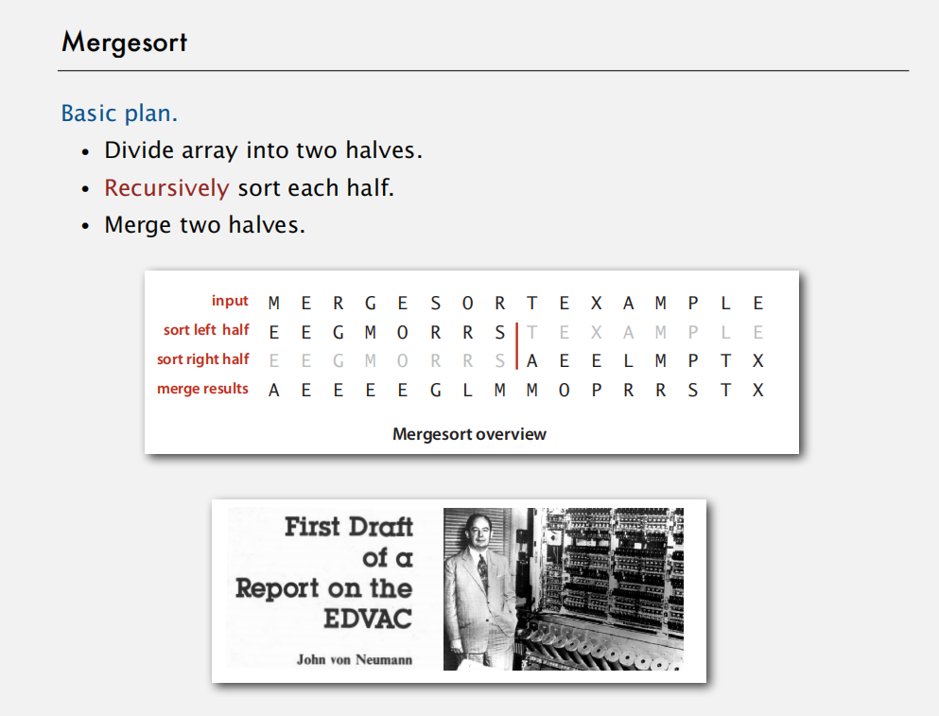

Slide 14
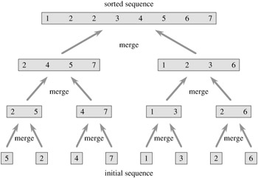
Merge Sort
Divide and conquer algorithm
Recursive algorithm
Split the list
Apply merge sort to the smaller lists
After the smaller lists are collected: MERGE
(Note that each of the sublists is already sorted)

Slide 15
Exercise: Bubble sort and comparison to Python sorting algorithm
Bubble Sort: Sorting_Example Colab
Optional: LeetCode 912 - Sort an Array [Medium]
https://leetcode.com/problems/sort-an-array/
Optional: LeetCode 147 - Insertion Sort List [Medium]
https://leetcode.com/problems/insertion-sort-list/

Slide 16
Time for some exercise and discission.

